Slide 1
Implementation and Cost Estimation
Select
Join
Project

Slide 2
SELECT Operator
Retrieve all tuples in R whose values on attribute A satisfy certain condition
=, >, <, <>, !=
Factors to estimate the cost of performing a select operation
No index
unsorted data
sorted data
Index
tree index
hash-based index

Slide 3
Sailors(sid, sname, rating, age)
Each Sailors tuple is 50 bytes (fixed length record format)
Total number of tuples: 40,000
A page size is 4K bytes
All pages are full, unpacked bitmap; 96 bytes are reserved for slot directory
How many pages for Sailors?
Slot 1
Slot 2
Free
Space
. . .
Slot N
Slot M
1
. . .
0
1
1
M
M ... 3 2 1
number
of slots
One page can contain at most (4096-96)/50 = 80 tuples
Sailors occupies pages 40,000/80 = 500

Slide 4
No index, unsorted data
Suppose R is Sailors
Best access path: File Scan
I/O Cost: 500 pages
I/O time cost: 500 * time to access each page
Complexity: O(|R|)
Notation: |R| is the number of pages in R

Slide 5
No Index, sorted file on R.A
Suppose R is Sailors
Sorted on R.A
Best Access Path:
Binary search to locate the first tuple with R.A=Value
Scan the remaining records
I/O Cost:
log₂(|R|)+Cost of scan for remaining tuples (0 ~ |R|)

Slide 6
Tree Index on R.A
Selection Cost =
cost of traversing from the root to the leaf +
cost of retrieving the pages in the sequence set +
cost of retrieving pages containing the data records.
Need to know
Clustered or unclustered
Dense or sparse
Index entries
Data entries
Data Records
B+-tree, mostly used indexing in RDBMS

Slide 7
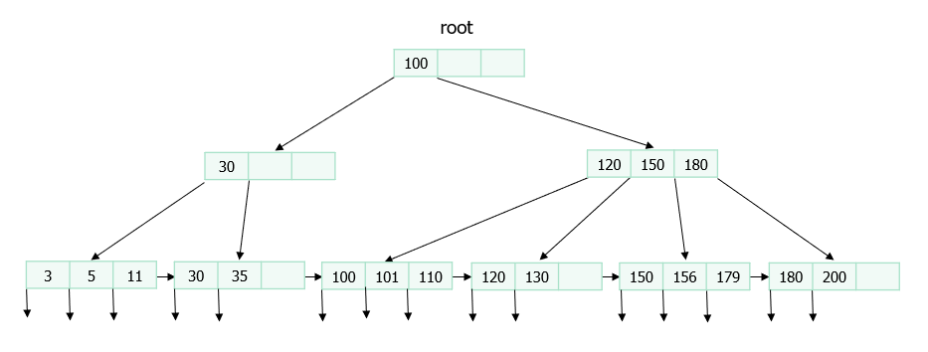
B⁺-Tree
Paged and balanced-tree: each node takes a whole page and the depth from root to leave is the same
B⁺-tree is featured being short (usually 3 or 4 layers) and fat (with a large number of fanouts)
Employee Number, Company
index node
directory node
data entry node
Search key
3, A
101, B
4, C
data node
data page
record page
119, E
2, X
115, Y
Notes:
a data file is a sequence of pages, each storing a number of records

Slide 8
Equality Search
Start from the root, find the pointer whose left key and right key values contains the search key value
Follow the pointer to the linked node, repeat until reaching a data node
Search the records in the data node and return those that match
Range search (similar procedure)
B⁺-Tree
Employee Number, Company
index node
directory node
data entry node
Search key
3, A
101, B
4, C
data node
data page
record page
119, E
2, X
115, Y
Notes:
a data file is a sequence of pages, each storing a number of records

Slide 9
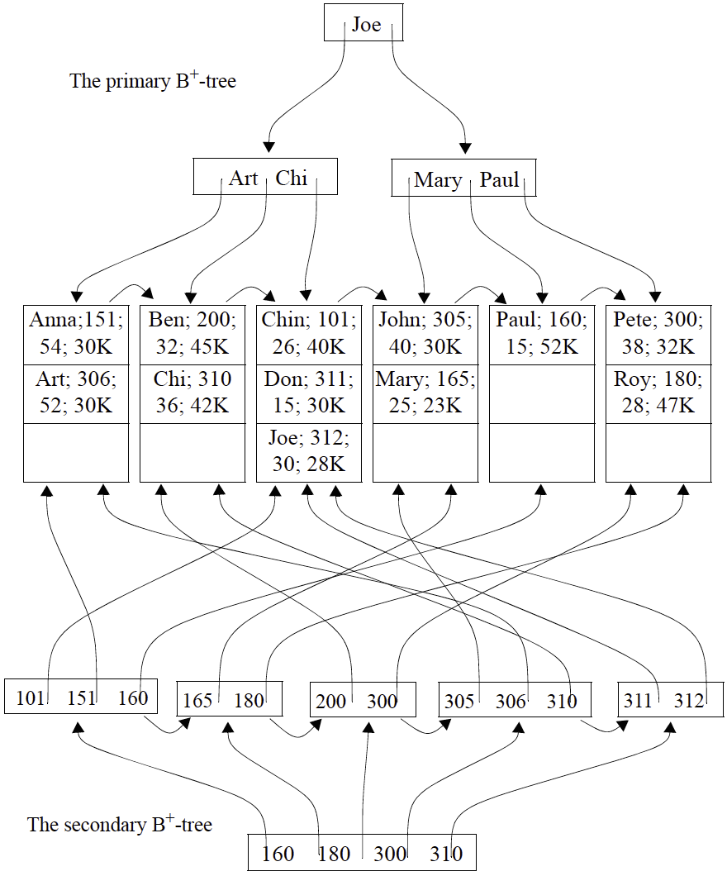
Primary index on names
can be sorted
Secondary index on ID
cannot sorted, otherwise would have duplicated the records
Type of B+-tree
Clustered/unclustered
Dense/sparse

Slide 10
Dense or Sparse
DENSE INDEX
SPARSE INDEX
Index entries
direct search for
data entries
Data entries
Data entries
(Index File)
(Data file)
Data Records
Data Records
Dense: At least one data entry per data record
Sparse: At least one data entry per block/page
Pros and Cons:
Dense: less space-efficient, but great for both equality and range search
Sparse: more space-efficient, but need sequential search within a page

Slide 11
Clustered or Unclustered
CLUSTERED INDEX
UNCLUSTERED INDEX
Index entries
direct search for
data entries
Data entries
Data entries
(Index File)
(Data file)
Data Records
Data Records
Clustered Index :
The ordering of data records is organized the same as or close
to the ordering of data entries in the index
Sparse index is always clustered, e.g., alternative 1 can be regarded as sparse (why?)
A clustered index does not have to be sparse (why?)
Pros and Cons:
Clustered: maintenance cost high, but great for range search
Unclustered: low maintenance cost, but high retrieval cost
Retrieving one record may need to load one page

Slide 12
Dense/Sparse?
Clustered/Unclustered ?
Root
13
17
24
30
2*
3*
5*
7*
14*
16*
19*
20*
22*
24*
27*
29*
33*
34*
38*
39*

Slide 13
Tree Index on R.A
Selection Cost =
cost of traversing from the root to the leaf +
cost of retrieving the pages in the sequence set +
cost of retrieving pages containing the data records.
Need to know
Clustered or unclustered
Dense or sparse
Index entries
Data entries
Data Records

Slide 14
B⁺-tree Index on R.A
dense, unclustered
Size of data entry = 20 bytes;
Page size=4K bytes; 96 bytes are reserved
Total number of records = 100,000; record size = 40 bytes
Reduction Factor = 0.1
#matching entries/#total entries
Total Cost =
Cost of traversing from the root to the leaf (assume 4 I/Os) +
Cost of retrieving the pages in the sequence set +
the cost of retrieving pages containing the data records

Slide 15
Size of data entry = 20 bytes;
Page size=4K bytes; 96 bytes are reserved
Total number of records = 100,000; record size = 40 bytes
Reduction Factor = 0.1
B⁺-tree, dense, unclustered
I/O cost of retrieving pages of qualifying data entries
Matching data entries: 0.1*100,000=10,000 entries
#Date entries per page:
Pages of matching data entries = 10,000/200 = 50 pages
I/O cost of retrieving qualifying tuples
10,000 pages since the index is unclustered, the qualifying tuples are not always in the same order as the data entries.
In the worst case, for each qualifying data entry, one I/O is needed
Total I/O Cost = 4+ 50+10,000 pages
UNCLUSTERED INDEX
Data entries
Data Records

Slide 16
B⁺-tree, dense, clustered
I/O cost of retrieving pages of qualifying data entries
Matching data entries: 0.1*100000=10000 entries
#Date entries per page:
#Pages of matching data entries =
I/O cost of retrieving qualifying tuples
#Matching tuples: 10000
Since the index is dense and clustered, the qualifying tuples are also clustered
# pages: 10000/100=100 due to (4096-96)/40=100 tuples per page
Total I/O Cost = 4+ 50+100 pages
CLUSTERED INDEX
Data entries
Data Records

Slide 17
B⁺-tree, sparse (must be clustered)
I/O cost of retrieving qualifying tuples
#Matching tuples: 0.1*100,000=10,000
Since the index is clustered, the qualifying tuples are also clustered
# pages: due to 100 tuples per page
I/O cost of retrieving pages of qualifying data entries
Matching data pages: 100
#Data entries per page:
#Pages of matching data entries = = 1 page
Total I/O Cost = 4+ 1+100 pages
CLUSTERED INDEX
SPARSE INDEX
Each entry links to one page
Data entries
Data Records

Slide 18
Hashed file (clustered based on hash value)
File is a collection of buckets.
Bucket = primary page plus zero or more overflow pages.
Hashing function h: h(r) = bucket in which record r belongs. h looks at only some of the fields of r, called the search fields.
h(age)=0
Smith, 40, 3000
Jones, 40, 6003
Tracy, 40, 5004
Doug, 20, 3800
age
h1
h(age)=1
Ashby, 21,3000
Basu, 31, 4003
Bristow, 21, 2007
overflow pages
h(age)=9
Cost = the number of pages in bucket with the corresponding hash value
Class, 59, 5004
Daniels, 29, 6003
Efficiency depends on
Hash function
Data skew factor
File hashed on age

Slide 19
Hash-based Index
Hashed index
The records have been sorted according to names.
Data records
Data entries
Ashby, 25, 3000
3000
3000
h(sal)=00
Basu, 33, 4003
5004
5004
sal
Bristow, 30, 2007
h
Data File
4003
h(sal)=11
Cass, 50, 5004
2007
6003
Daniels, 22, 6003
6003
Jones, 40, 6003
I/O cost = cost for retrieving the matching data entries + cost for retrieving the qualifying tuples

Slide 20
Total number of records: 100,000
Reduction Factor: 0.01 (the rate of the records that satisfy the query condition over the total number of records)
Cost for searching the matching data entry: 1.2 I/O
Each page holds 1000 of data entries
I/O cost = cost for retrieving the matching data entries
+ cost for retrieving the qualifying tuples
I/O cost of retrieving pages of matching data entries
Matching data entries: 0.01*100,000
Number of pages of matching data entries: 0.01*100,000 / 1,000 = 1 pages
I/O cost = 10 *1.2, estimated as 2 pages
I/O cost for retrieving the qualifying tuples = 1,000 pages (or the maximum pages)
Total cost = 2+1,000 = 1,002 pages

Slide 21
Factors to Consider
No index
unsorted data
sorted data
Index
tree index
clustered/unclustered
dense/sparse
hash-based index

